Slide 1
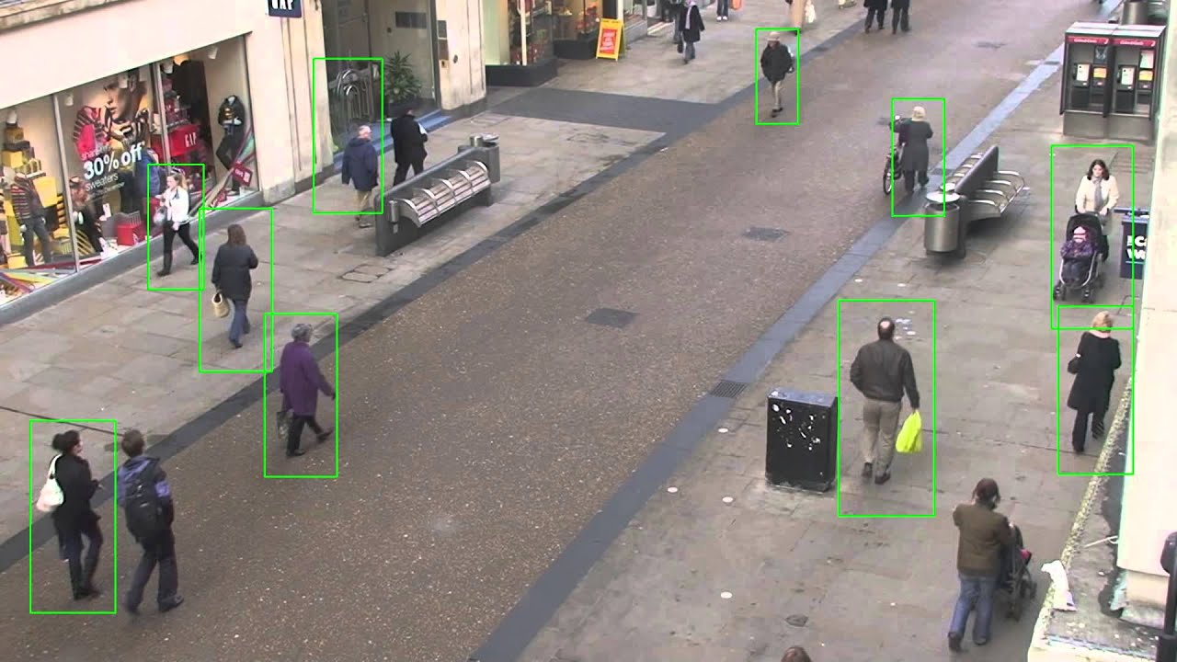
People detection in images
By Ivana Akrum

Slide 2
State of the Art Analysis

Slide 3
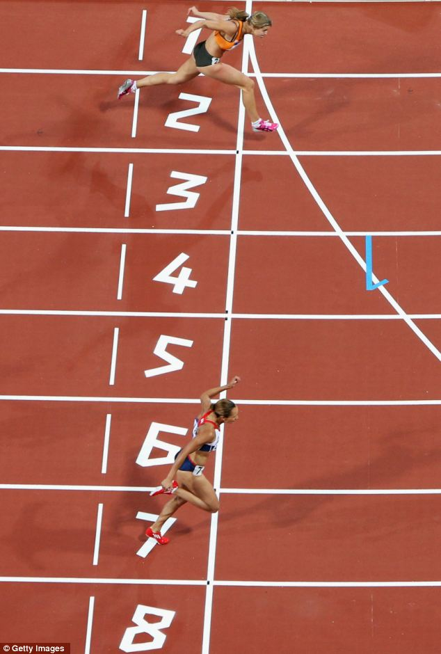
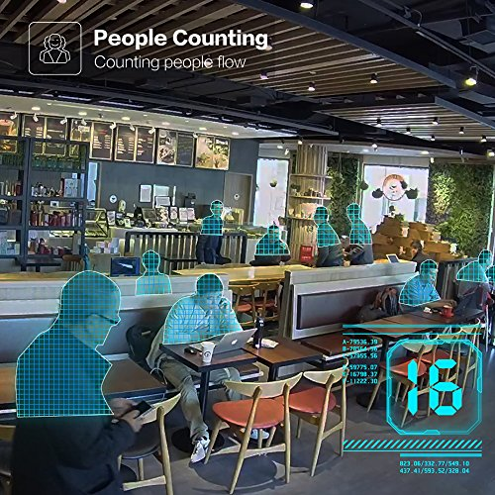
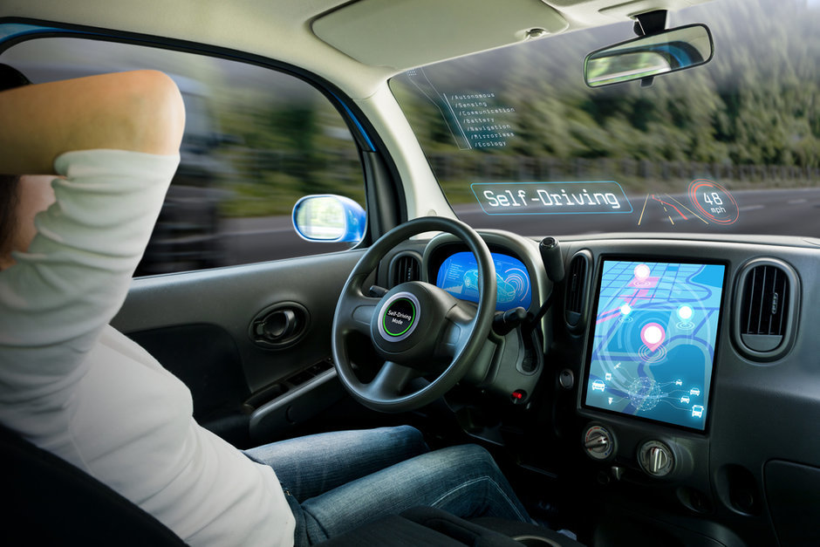
Applications
Self-driving cars
Digital referees
Marketing
Notes:
Self-driving cars: pedestrians crossing the street
Digital referees: Who crossed the finish line first
Marketing: How many people at my event

Slide 4
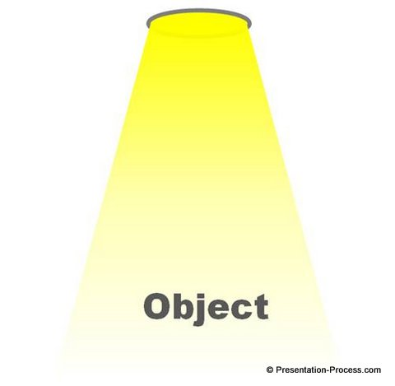

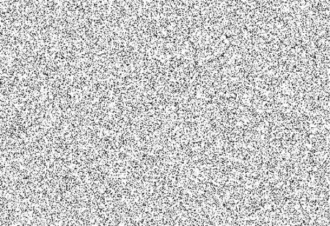

Challenges
Illumination
Noise
Angle
Pose
Notes:
Illumination people wear different clothing of various colours and textures

Slide 5
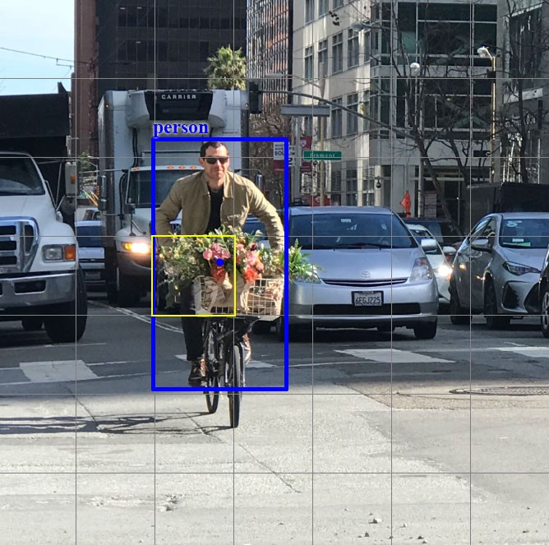
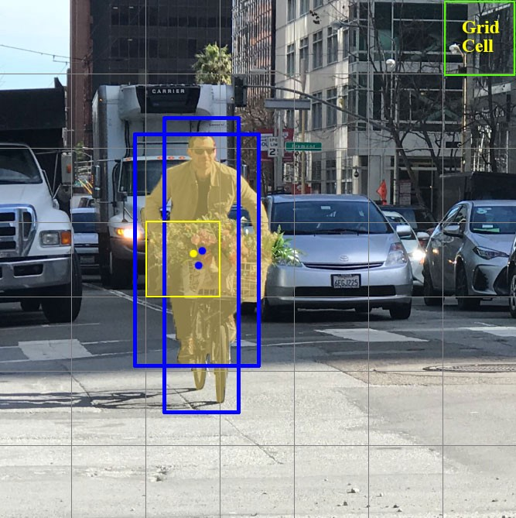
First Solution
Scan image with a “window”
Classify each window
Merge neighbouring windows (NMS)
Notes:
NMS = non-maximum suppression

Slide 6
State-of-the-Art
Template matching (Gavrila & Philomin, 1999)
Histogram of oriented gradients (HOG)
Local binary pattern (LBP)

Slide 7
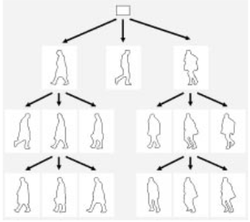
Template matching (Gavrila & Philomin, 1999)
Pixel level edge-based features
Location, orientation , and/or magnitude
Individual pixels
Location = Distance to nearest pixel on a template
Sensitive to noise
Pose-specific (computationally heavy)
Templates in tree structure

Slide 8
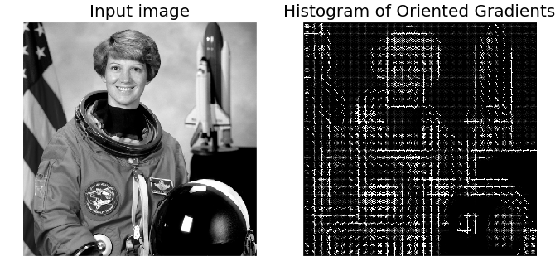
Histogram of oriented gradients (HOG)
Region level edge-based features
Local image regions
Local rectangular region
Magnitudes to bin weights
Each bin corresponds to an edge orientation
Combined with feature selector

Slide 9
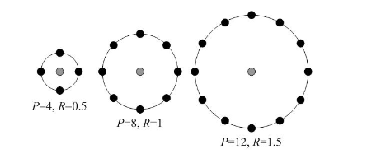
Local binary pattern (LBP)
Intensity feature
Texture classification
Robust against illumination
Computationally simple

Slide 10
Classification Algorithms
Generative
Discriminative
Model (template matching)
Implicit Shape Model (ISM)
Appearance captured in codebook
Codewords match a feature
Codewords vote towards location
SVM
Adaboost
Neural Networks
Notes:
Adaboost: converts set of weak classifiers into a strong one
SVM: support vector machine

Slide 11
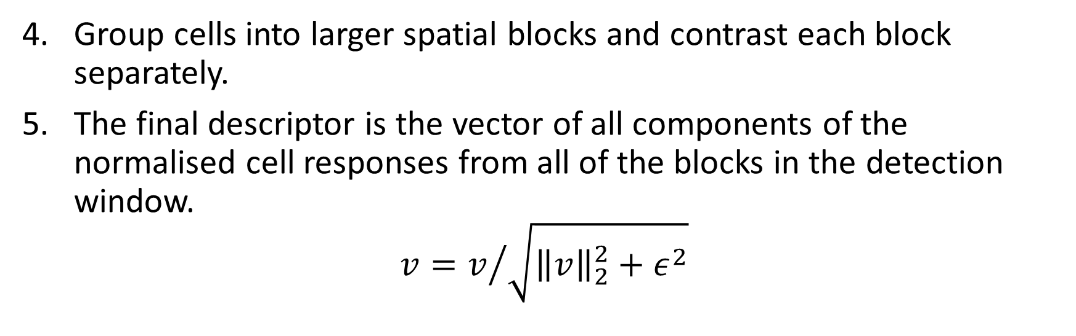
HOG Methods (Dalal & Triggs, 2005)
Each pixel calculates a weighted vote for an edge orientation histogram channel. The votes are accumulated into orientation bins over cells.
The vote is equal to the gradient magnitude at the pixel.
Group cells into larger spatial blocks and contrast each block separately.
The final descriptor is the vector of all components of the normalised cell responses from all of the blocks in the detection window.
$$v=v/{\sqrt{{\left\|v\right\|}_{2}^{2}+ε^{2}}}$$
Square root gamma compression of each colour channel
Compute gradients for each colour channel
Take largest norm as pixel’s gradient vector

Slide 12
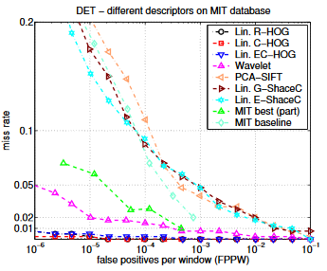
HOG Metrics (Dalal & Triggs, 2005)
False Positives per Windows (10⁻⁴ FPPW)
Detection Error Tradeoff (DET) curves (log-log scale)
Miss rate versus FPPW
Lower values are better

Slide 13
Datasets
General purpose
MIT
INRIA
Penn-Fudan
USC-A
USC-C
PASCAL VOC
H3D
Surveillance
USC-B
CAVIAR
Pedestrian detection
Caltech
TUD
CVC
DaimlerChrysler (DC)
ETH

Slide 14
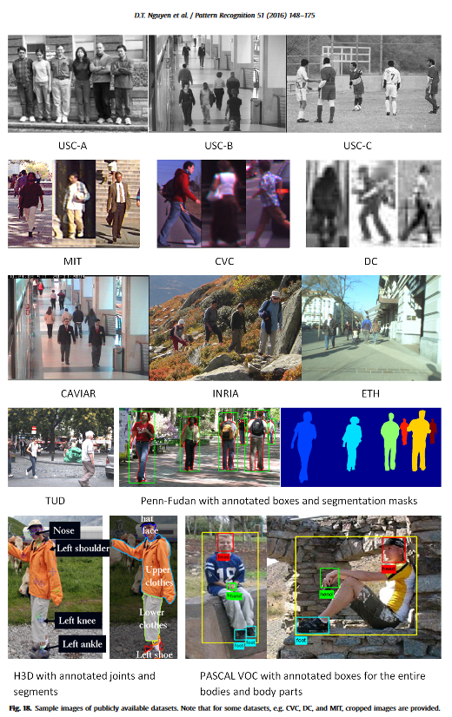
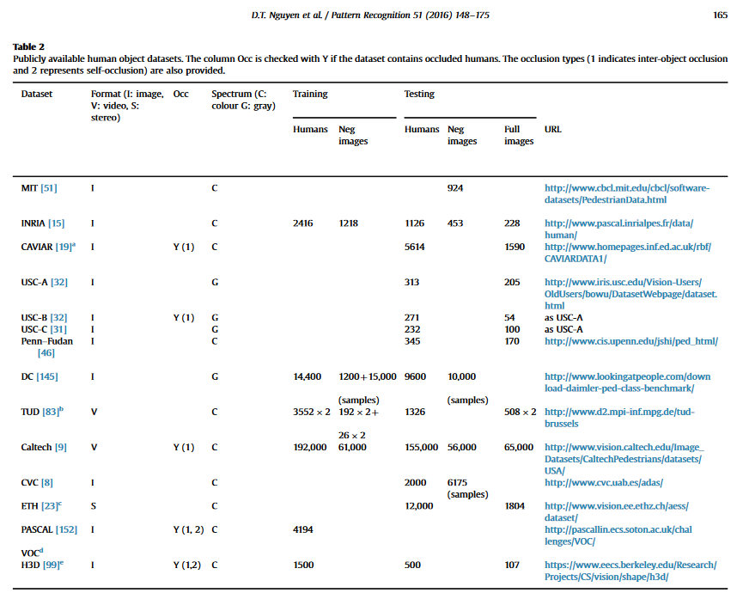
Datasets

Slide 15
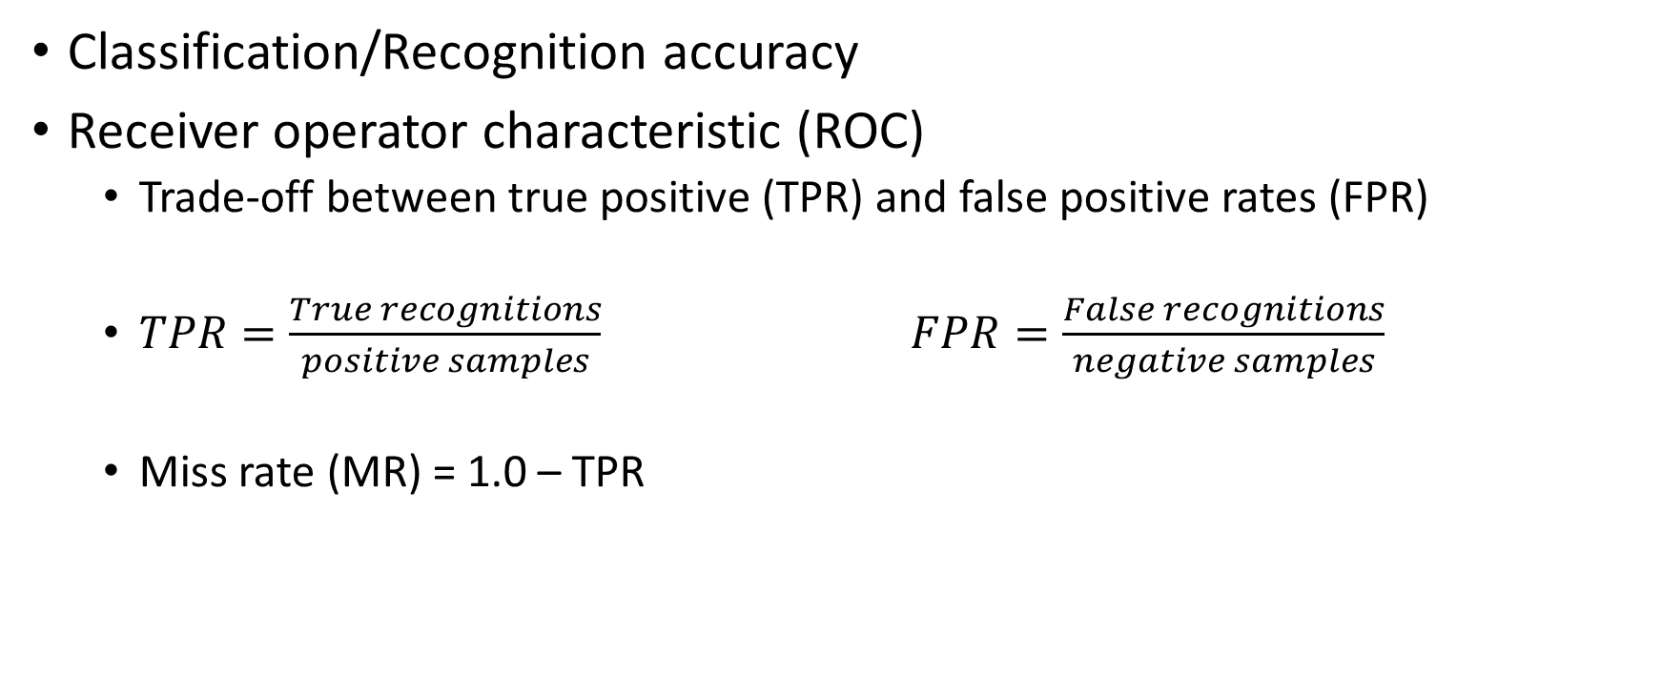
Typical metrics
Classification/Recognition accuracy
Receiver operator characteristic (ROC)
Trade-off between true positive (TPR) and false positive rates (FPR)
$TPR=\frac{True recognitions}{positive samples}$ $FPR=\frac{False recognitions}{negative samples}$
Miss rate (MR) = 1.0 – TPR

Slide 16
Python Implementation
Using cv2 built-in HOG + SVM implementation
https://www.pyimagesearch.com/2015/11/09/pedestrian-detection-opencv/

Slide 17
Implementation

Slide 18
Datasets Original
INRIAPerson: http://pascal.inrialpes.fr/data/human/
PennFudanPed: https://www.cis.upenn.edu/~jshi/ped_html/
Colour images
Single- and multiple persons
With- and without overlap
Penn-Fudan 170 positive images
INRIA 288 positive test images, 453 negative test images
Notes:
Self-driving cars: pedestrians crossing the street
Digital referees: Who crossed the finish line first
Marketing: How many people at my event

Slide 19
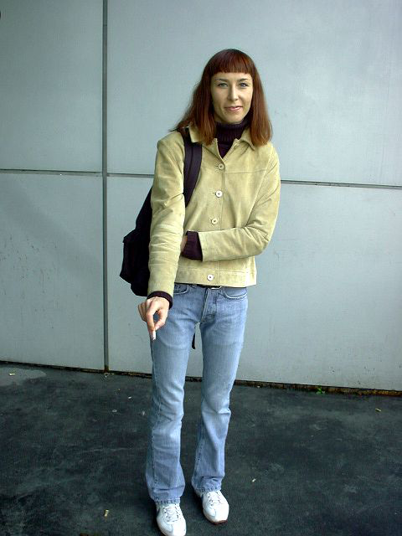
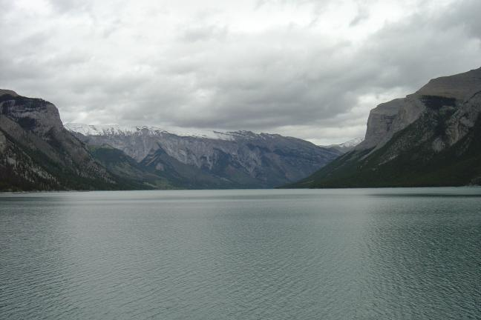
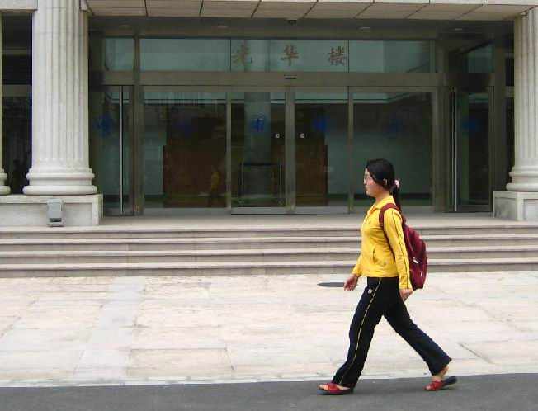
Dataset Final
Easy, 106 images
Negatives, 106 images
Notes:
Left: Inria
Right: Penn-Fudan

Slide 20
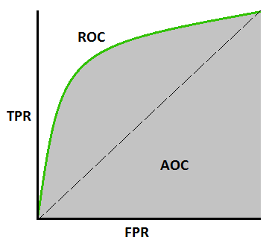
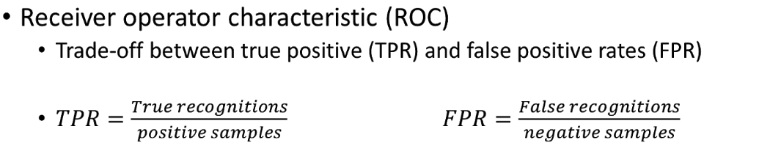
Performance methods
Annotations
True positives (TP), false positives (FP)
True negatives (TN), false negatives (FN)
Accuracy = (TP + TN)/(TP + TN + FP + FN)
Percentage of correctly classified samples
Notes:
Illumination people wear different clothing of various colours and textures

Slide 21
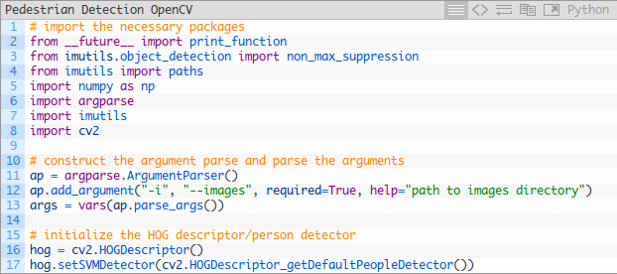
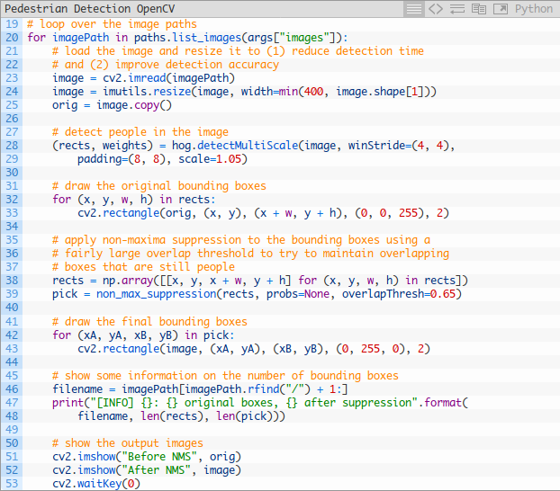
Selected Implementation Basis
Pedestrian Detection OpenCV
https://www.pyimagesearch.com/2015/11/09/pedestrian-detection-opencv/
pre-trained HOG + Linear SVM model
Dalal & Triggs, 2005
“Implementation of HOG (Histogram of Oriented Gradients) descriptor and object detector, the HOG descriptor algorithm introduced by Navneet Dalal and Bill Triggs” - OpenCV Documentation

Slide 22
Selected Implementation Adjustments
Set paths to read easy images, negative images, and annotations
Parse annotation text files to get true box dimensions
Implement intersection of union method to compare true against found boxes
Calculate performance metrics (tp, fp, tn, fn)

Slide 23
Experiment Goal
Research Question
“Can the Histogram of Gradients method in combination with a linear SVM be used to accurately detect people in images?”
Hypothesis: The HOG method in combination with a linear SVM can accurately detect people in ‘easy’ images.
Easy: little occlusion, little noise.

Slide 24
Experiment Set-up
Test the HOG detector against images of IRIA and Penn-Fudan datasets of differing difficulties.
Create a dataset of easy images from the IRIA and Penn-Fudan datasets.
Calculate true positives, false positives, true negatives, false negatives.
Calculate the True Positive and False Positive Rates.
Calculate accuracy score of the classification.

Slide 25
Performance methods (Reminder)
Annotations
True positives (TP), false positives (FP)
True negatives (TN), false negatives (FN)
Accuracy = (TP + TN)/(TP + TN + FP + FN)
Percentage of correctly classified samples
Notes:
Illumination people wear different clothing of various colours and textures

Slide 26
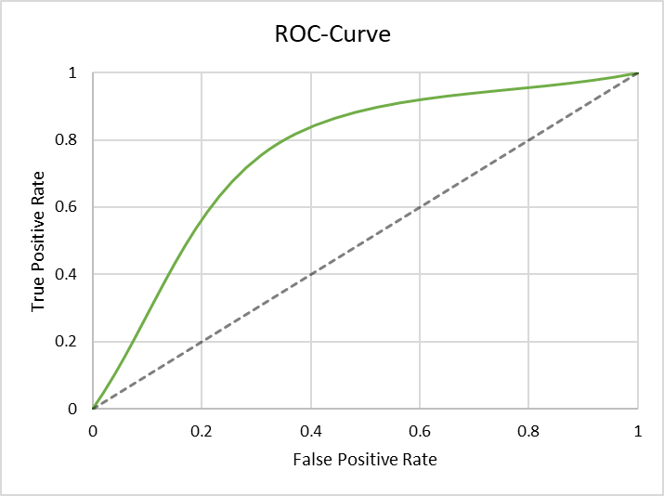
Results
Accuracy = 72.28%
True Positive Rate: 78.62%
False Positive Rate: 33.54%
 | Detected
True | Positives | Negatives
Positives | 114 | 53
Negatives | 31 | 105

Slide 27
Conclusions
Decent accuracy (72%), specifically:
Good at detecting humans when they are there (reasonably high TPR).
Will sporadically detect other objects as humans (FPR could still be lower).
Works better with smaller images. Resizing the positive images requires new annotations, however.

Slide 28
References
Nguyen, D. T. (2012). Human detection from images and videos (Doctor of Philosophy thesis). University of Wollongong. Retrieved March 24, 2019, from http://ro.uow.edu.au/theses/3665
Nguyen, D. T., Li, W., & Ogunbona, P. O. (2016). Human detection from images and videos: A survey. Pattern Recognition, 51, 148-175. doi:10.1016/j.patcog.2015.08.027
Gavrila, D., & Philomin, V. (1999). Real-time object detection for "smart" vehicles. Proceedings of the Seventh IEEE International Conference on Computer Vision. doi:10.1109/iccv.1999.791202
Mu, Y., Yan, S., Liu, Y., Huang, T., & Zhou, B. (2008). Discriminative local binary patterns for human detection in personal album. 2008 IEEE Conference on Computer Vision and Pattern Recognition. doi:10.1109/cvpr.2008.4587800
Dalal, N., & Triggs, B. (2005). Histograms of Oriented Gradients for Human Detection. In Proceedings of the 2005 IEEE Computer Society Conference on Computer Vision and Pattern Recognition (CVPR'05) (Vol. 1). Washington, DC. http://dx.doi.org/10.1109/CVPR.2005.177

